Slide 1


RnD Grants Management Portal CP301 Development Engineering Project(AY 2023-24) - Under the guidance of Dr. Puneet Goyal
Team T16
Lashyanth:2020csb1083
Sreya:2020csb1087
Vishnu:2020csb1097
Shruti: 2020csb1127
https://rndgrantst16.onrender.com http://172.30.8.212/

Slide 2
Idea Description
Project Topic: RnD Grants Management Portal
The project aims to develop a web-based platform for managing and tracking research and development grants.
The current system relies on manually updating Excel spreadsheets stored on local office computers, which becomes increasingly challenging as the number of projects and files grow.
The lack of a centralized system also makes it hard for faculty members and academic office members to access the latest information on specific grants, and generating reports is a time-consuming and complex process.
The new system will streamline grant management by providing a user-friendly interface for tracking and reporting grant information in real-time.

Slide 3
Expectations
Our goal is to transform the existing R&D grant application into a web-based platform capable of effectively managing grants.
Resolving any existing system issues to ensure smooth operation.
Introducing new features, and implementing constraints and security measures to meet the standards set by our university.
Finally bringing the portal to implementation by taking the feedback of the stakeholders.
Stakeholders
RnD grands management section – as Admins
Faculty – as professors
Fellow

Slide 4




Tech stack or Technologies used
FRONTEND
React JS
React Bootstrap
Material UI
Sheet JS
BACKEND
Node JS
Express
Google oAuth
DEPLOYMENT
1.Render
2.Server
Nginx, PM2, PostgreSQL
DATABASE
PostgreSQL
Deployment status
ON RENDER
https://rndgrantst16.onrender.com

Slide 5
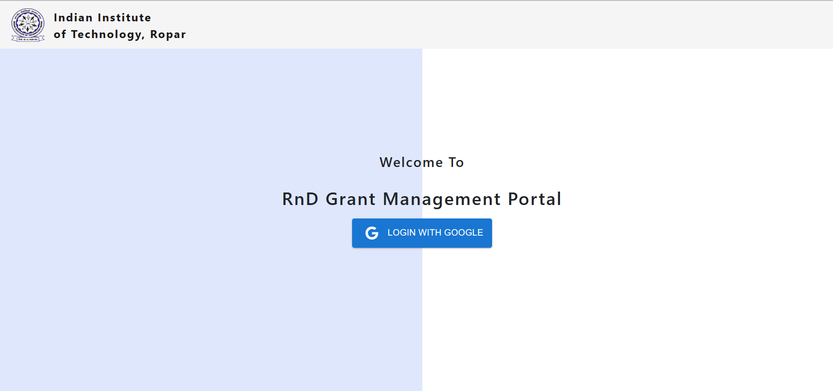
Functionality – Login
Only users who have access to the website can only login.
Admin will give the access to the users.
Stakeholders or who can login
Admin
Professor
fellow

Slide 6
Admin Page

Slide 7
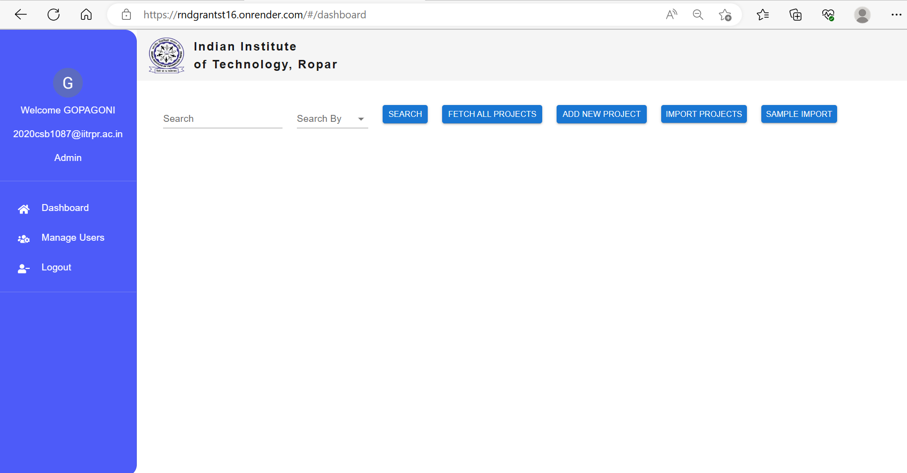
Functionality – Admin (Dashboard)
User role and details when logged in is mention here
This is the dashboard page for the admin. Which includes features
. Search, Sort
. Fetch all projects to view all the project details
. Add new projects manually using form
. Import projects from excel file
. sample import excel file which you can download for reference

Slide 8
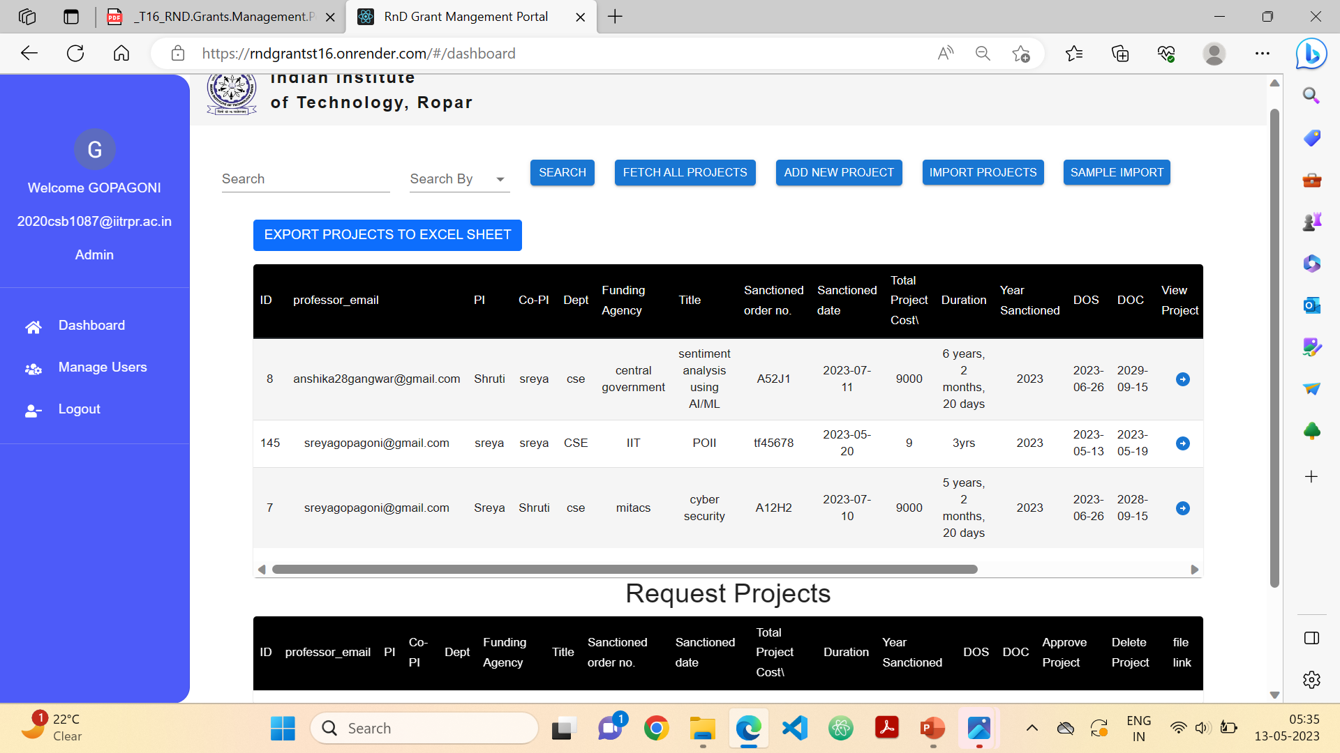
Functionality – Admin (Fetch all projects)

Slide 9

Dashboard
Export all projects in an excel file
View the details of the particular project
View the pdf of the sanctioned project details if provided.
Update the status of the project complete to running
or running to complete
Only Admin can delete the project

Slide 10
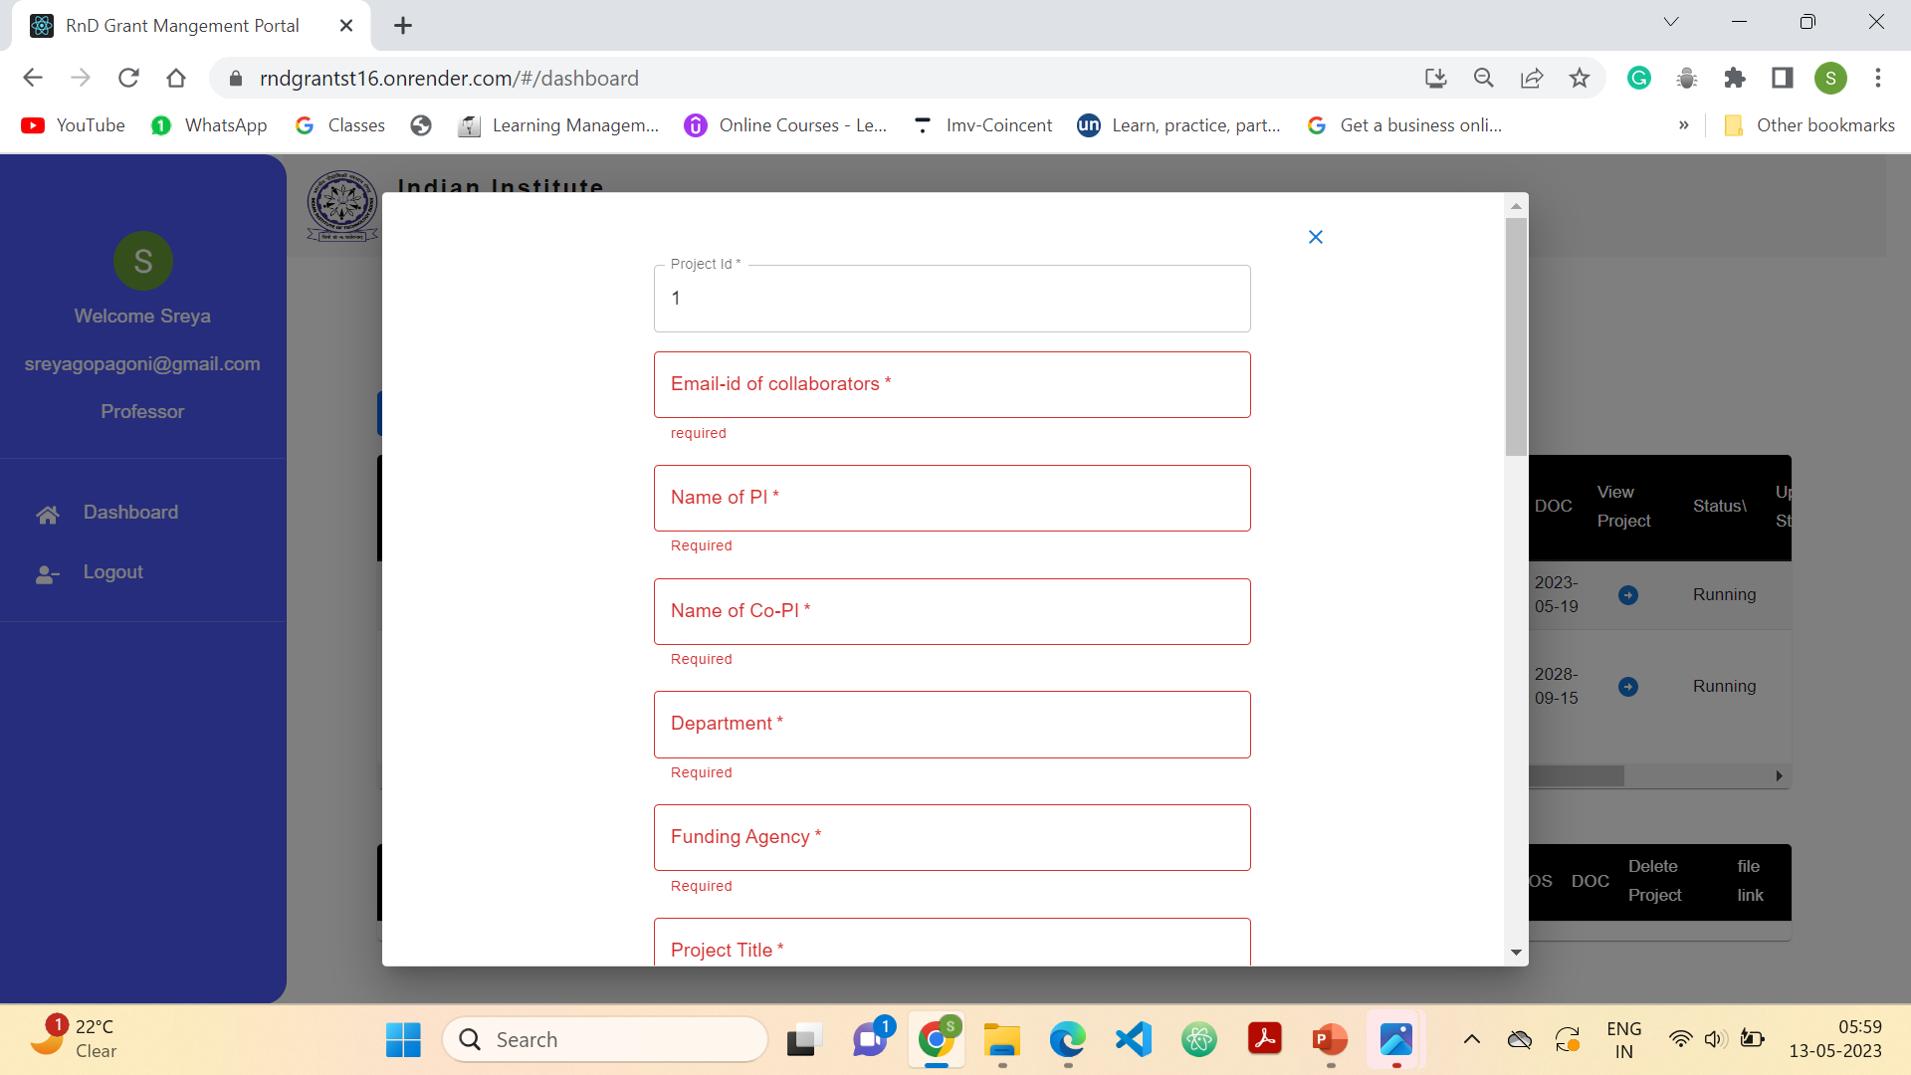
Functionality – Admin (add new project)
upload the excel file which contain details of all the projects. If needed see the sample impot file by clicking the sample import button
Manually add projects using form
Also implemented form validation and checks

Slide 11
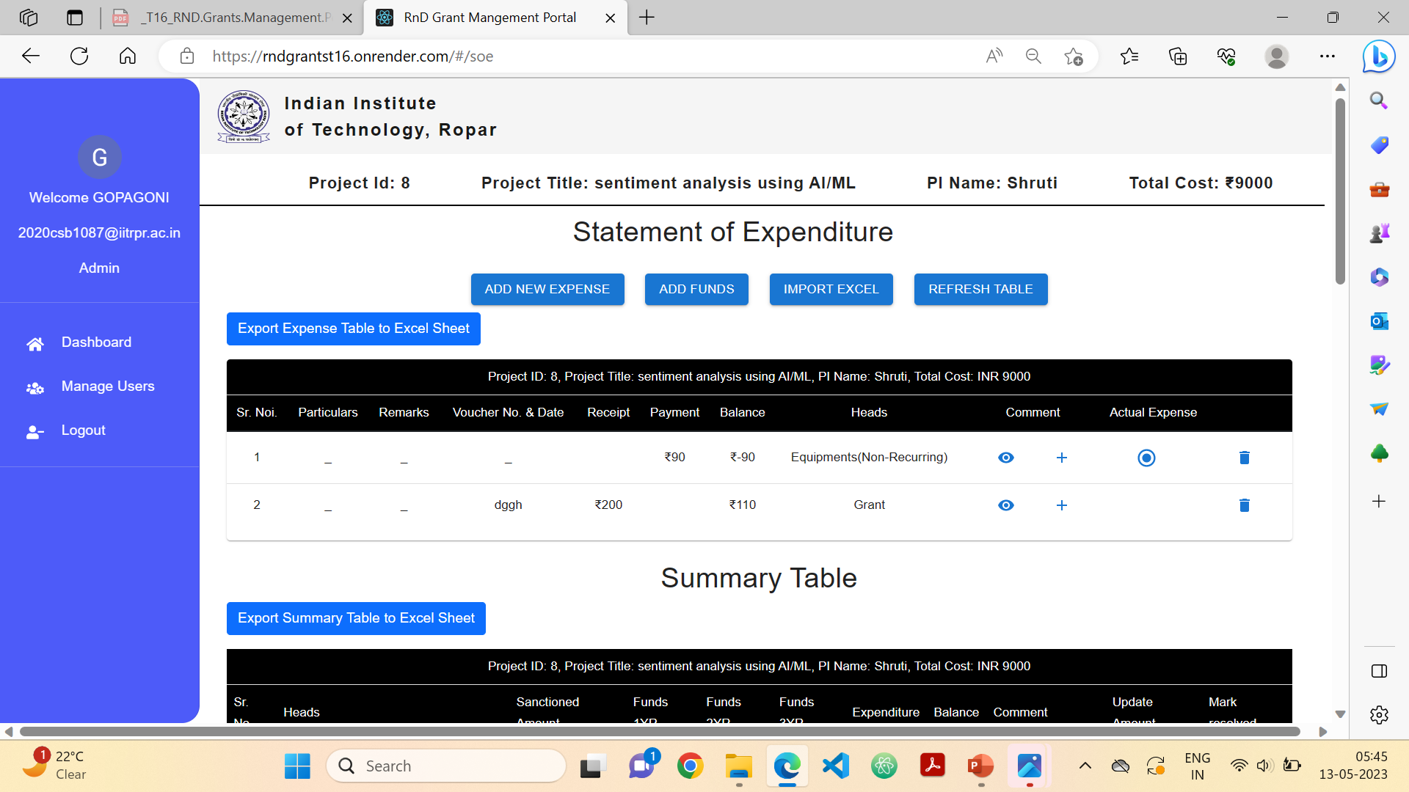
Functionality – Admin (view details of particular project)
Add all new expense or fund manually using a excel file
Add new expense or fund manually using form

Slide 12
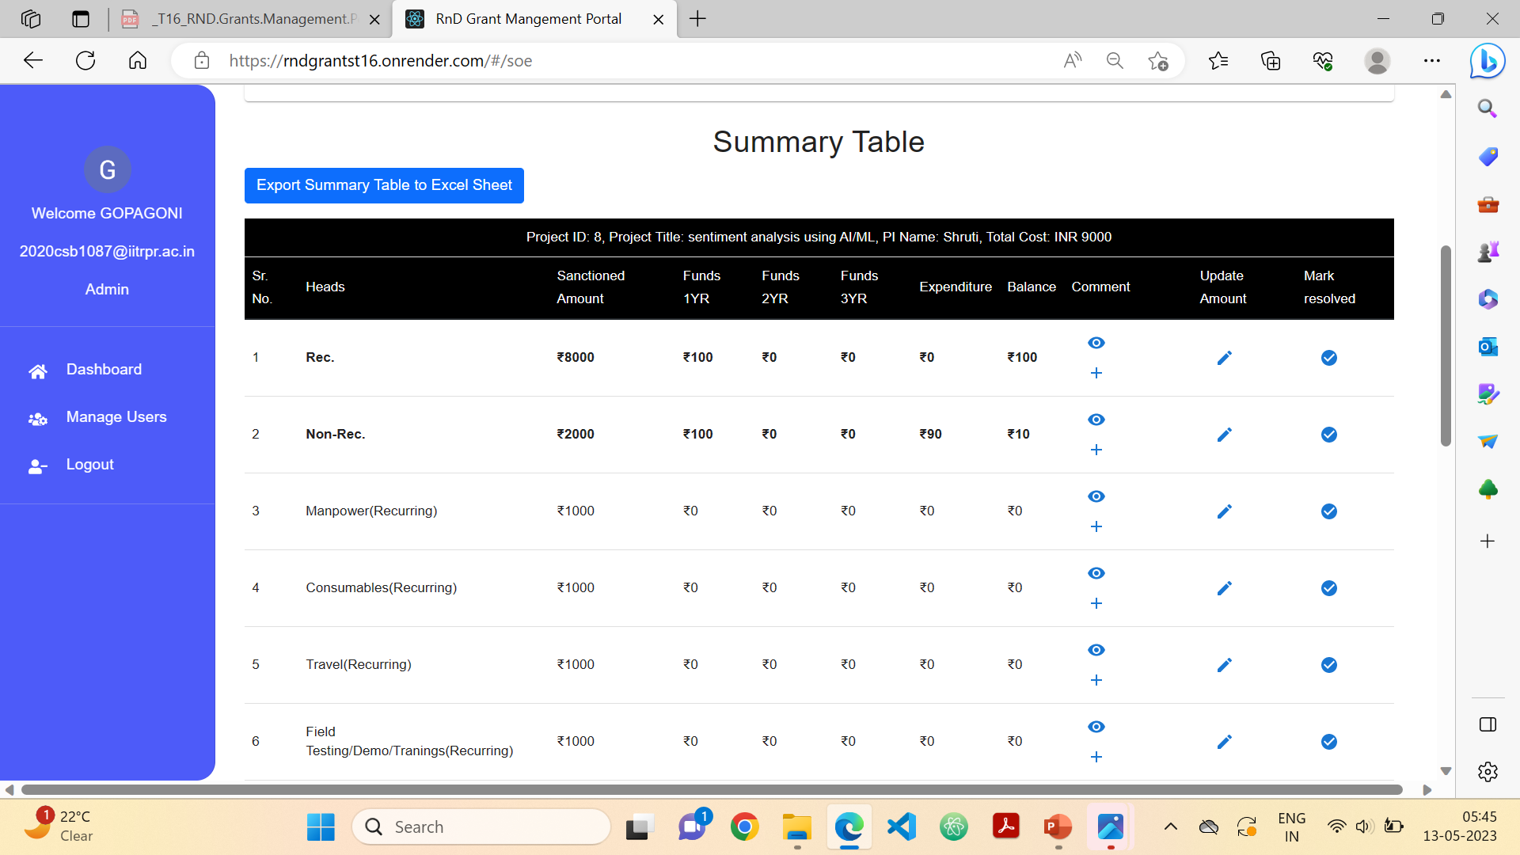
Dashboard
Edit the sanctioned amount
When seen the comment and want to resolve the comment
View or add comment

Slide 13
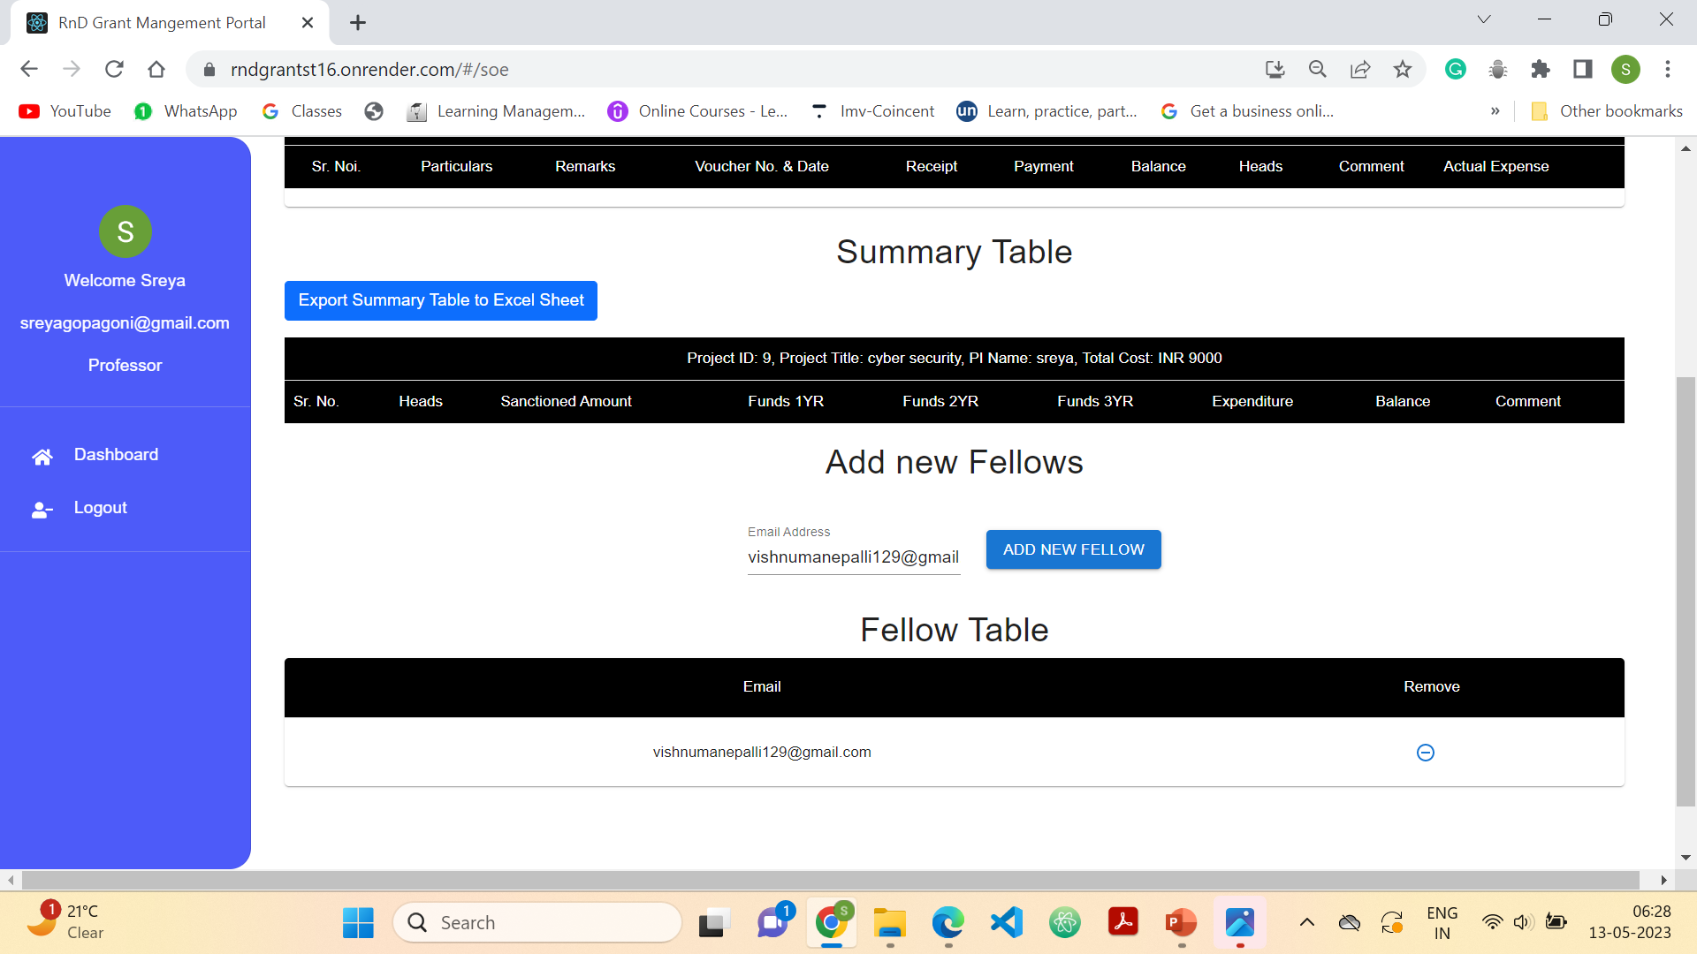
Functionality – Admin (Add a fellow to the project)

Slide 14
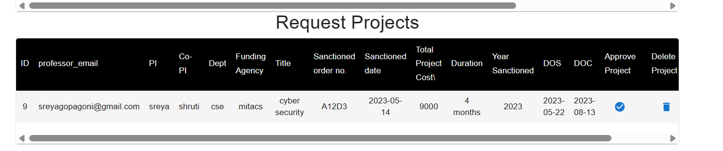
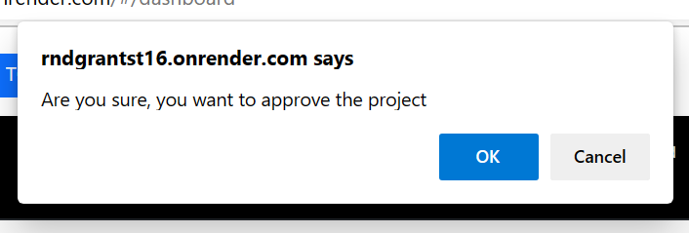
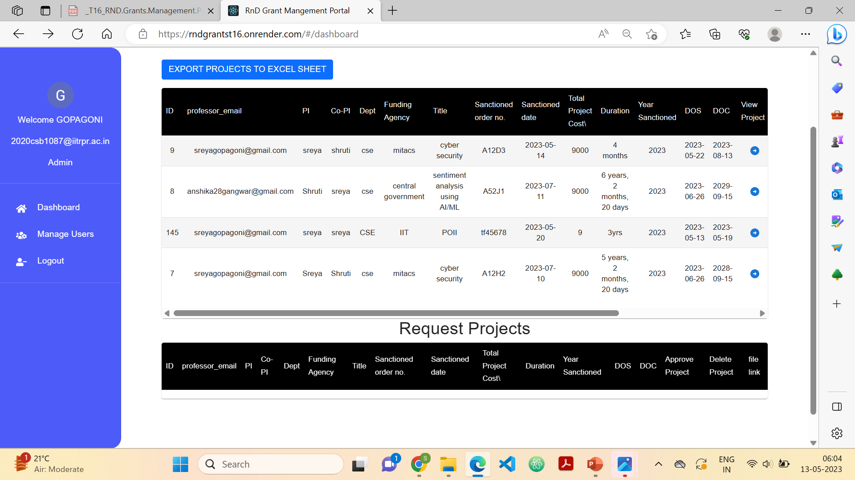
Functionality – Admin (Approve project)

Slide 15
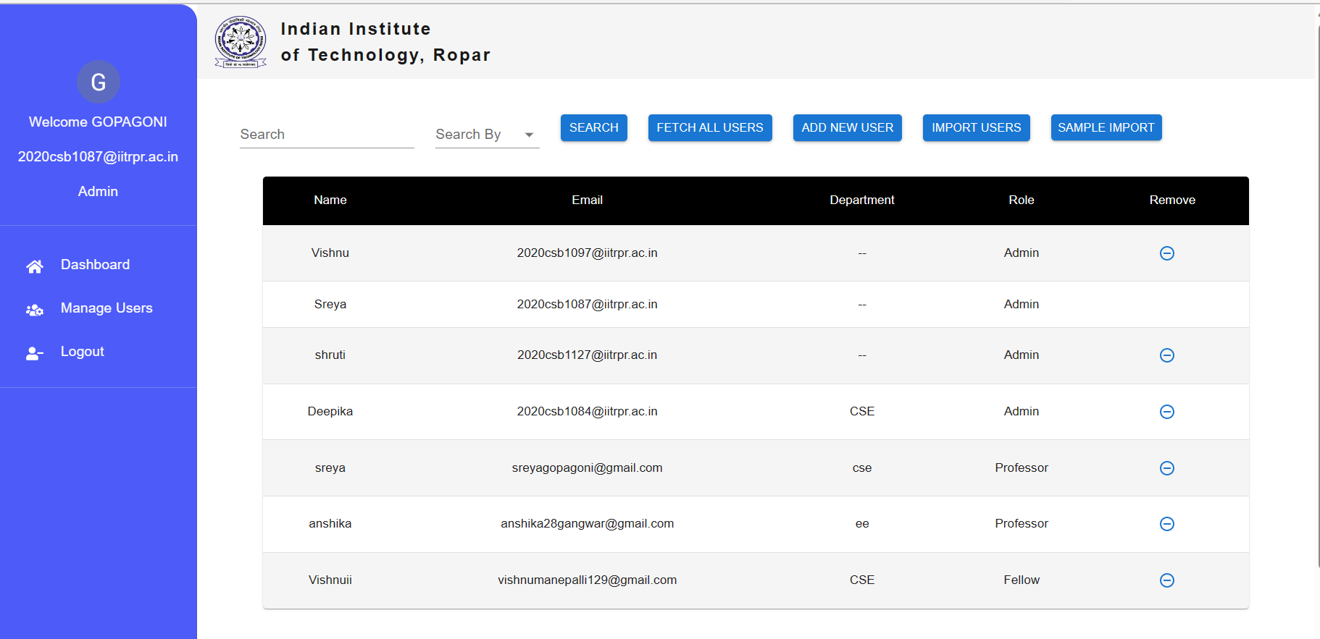
Functionality – Admin (Manage Usres)
Only Admin has manage users page Which includes features
. Search
. Fetch all users to view all the user details
. Add new user manually using form.
. Import users from excel file
. sample import excel file which you can download for reference

Slide 16
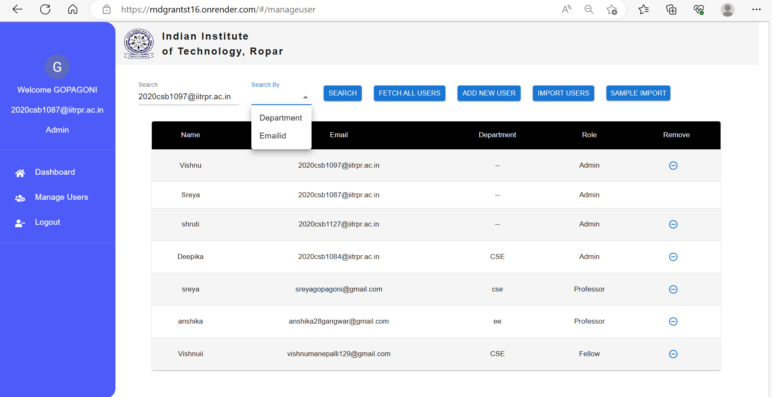
Functionality – Admin (Search)
Search User by department or email

Slide 17
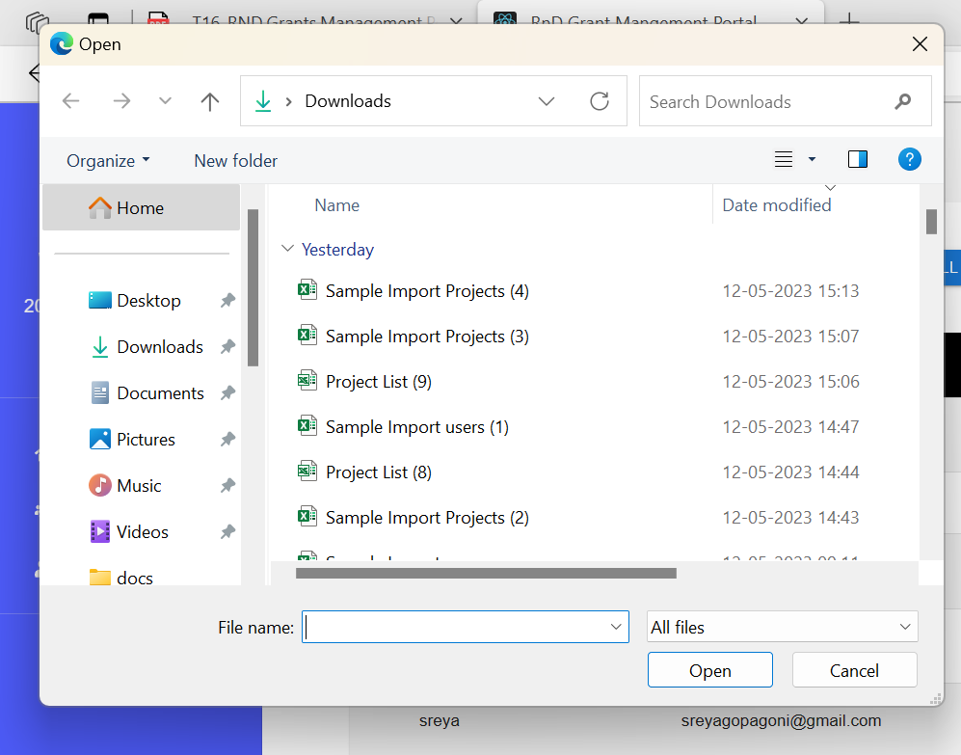
Functionality – Admin (Import users and Sample import)
Open the excel file which contain details of all the users. If needed see the sample impot file by clicking the sample import button

Slide 18
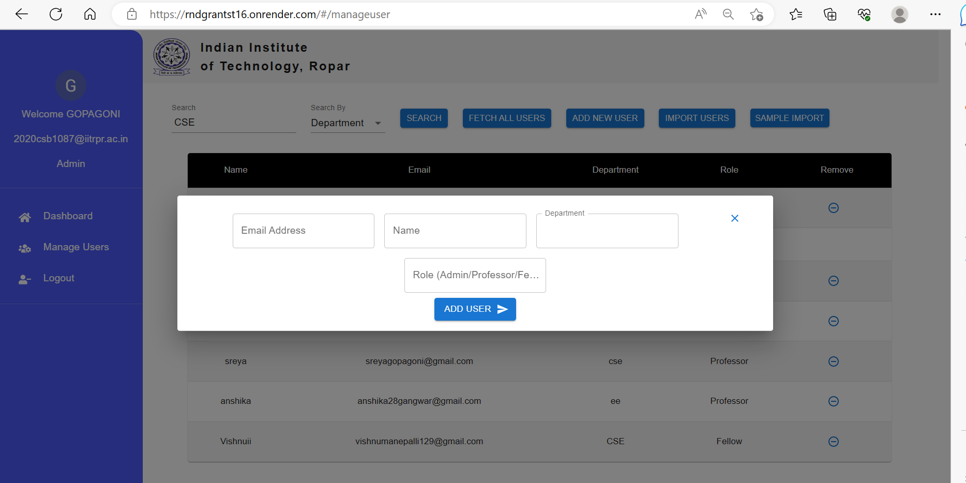
Functionality – Admin (Add new user using form)
I manually add a user by fille the form
Specify the role of the user 1 for admin/ 2 for professor, 3 for fellow

Slide 19
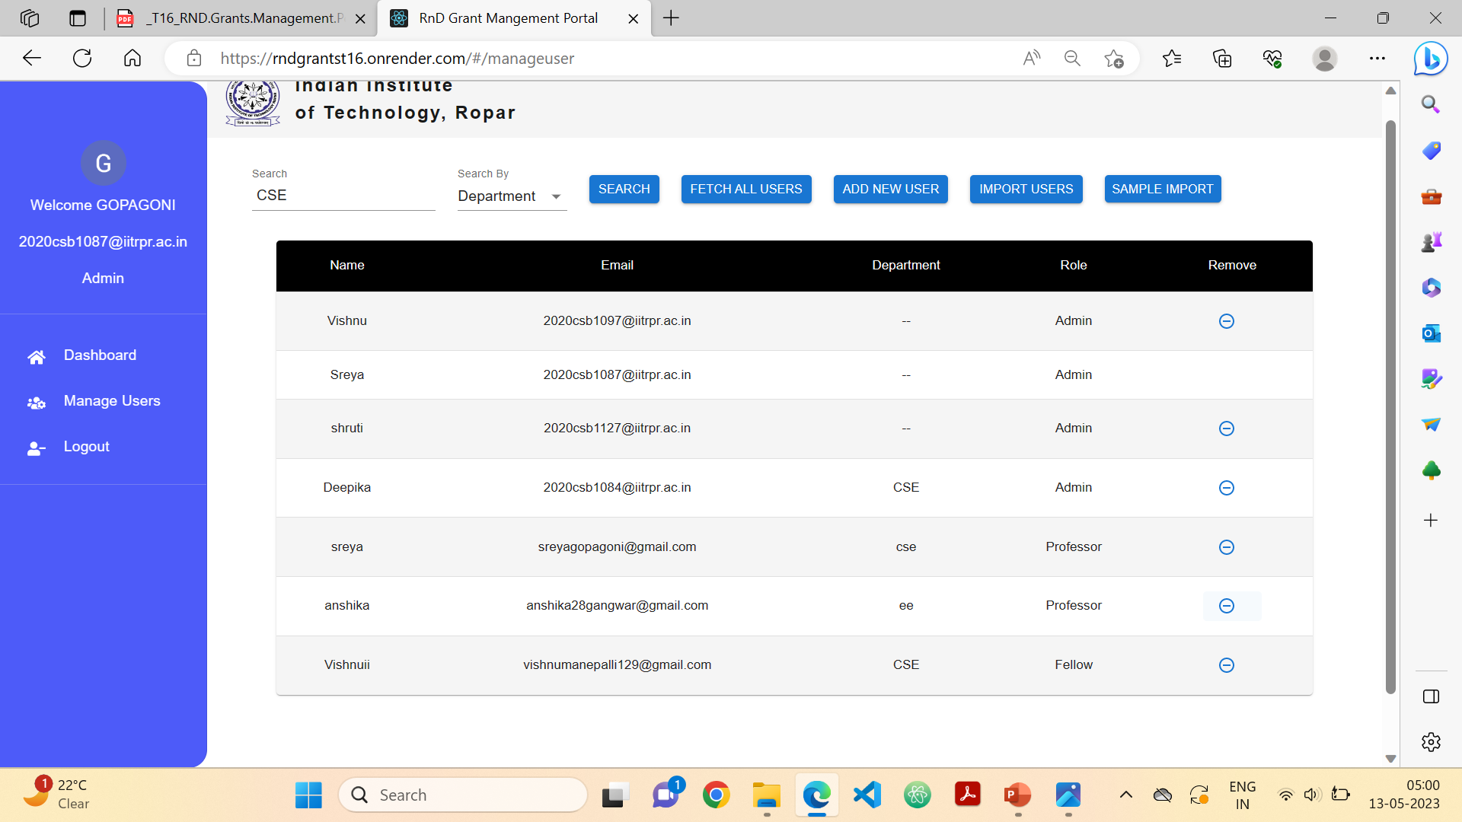
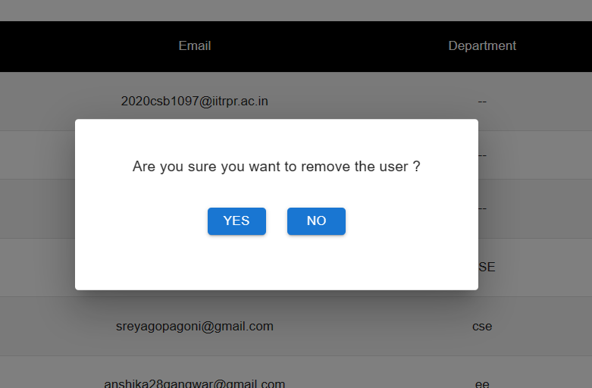

Functionality – Admin (Delete user)
Anishka user got deleted

Slide 20
Professor Page

Slide 21
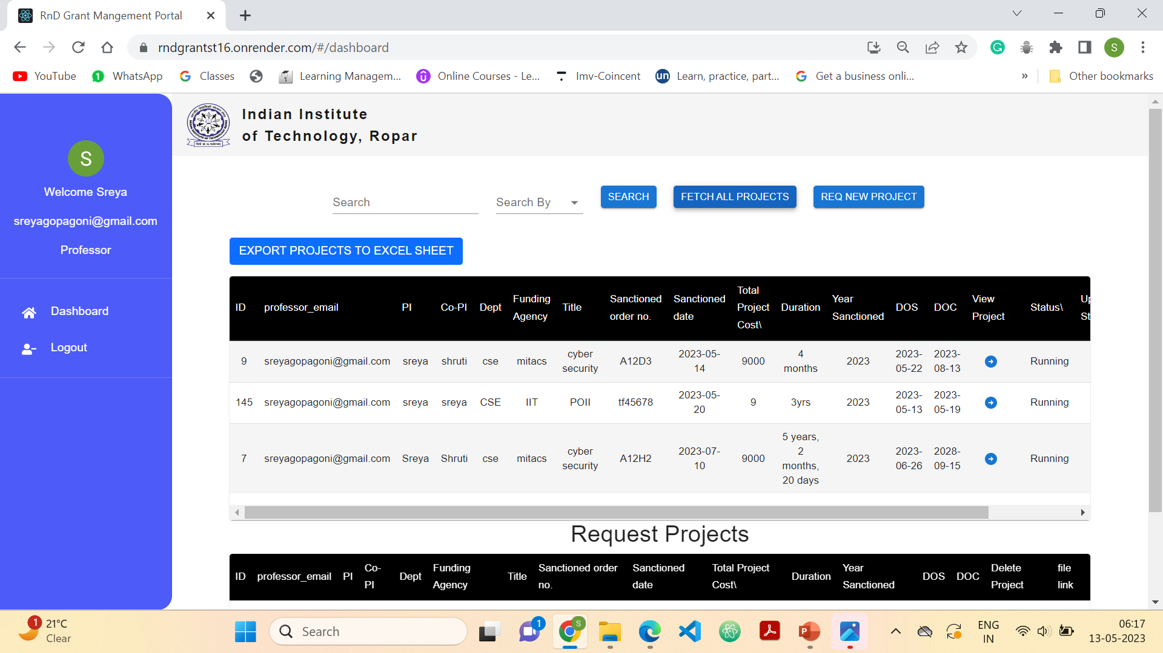
Functionality – Professor(Dashboard)
Can not delete the project.
View only his projects and that particular project details

Slide 22
Functionality – Professor(Request new project)
Also implement form validation and checks
Manually add projects using form
Professor can only request the project and admin approves it

Slide 23
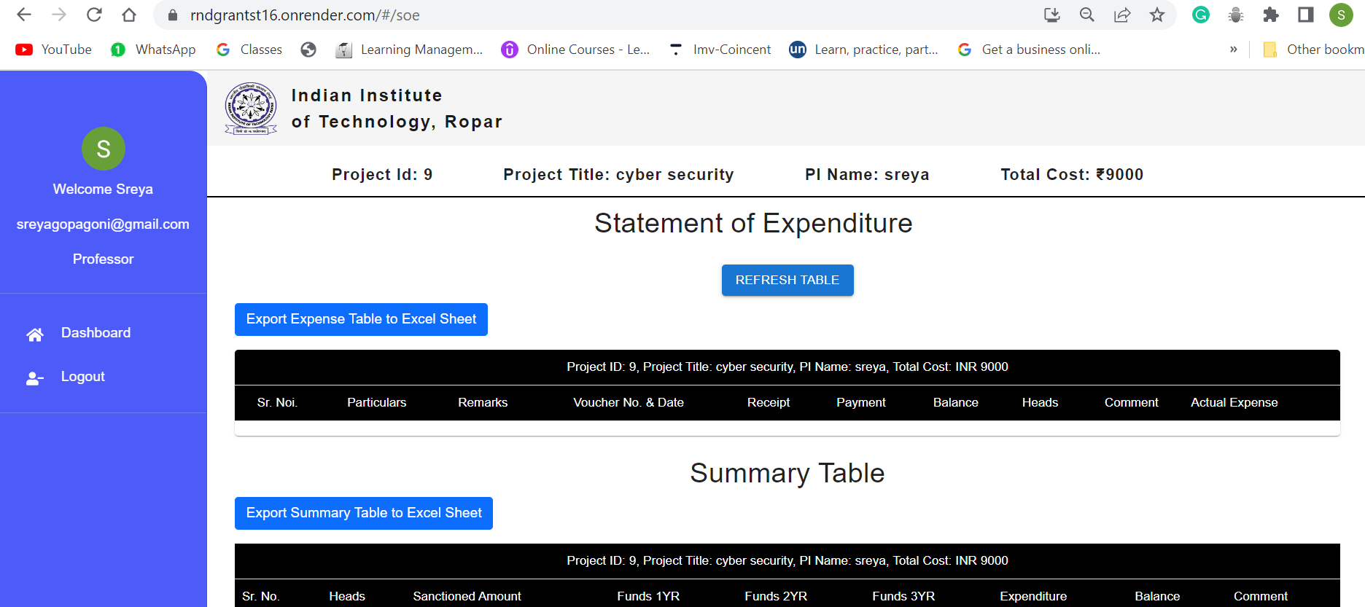
Functionality – Professor(View Project details)
Professor or fellow cannot add Expense or Funds can only see them

Slide 24
Functionality – Professor (Add a fellow to the project)

Slide 25
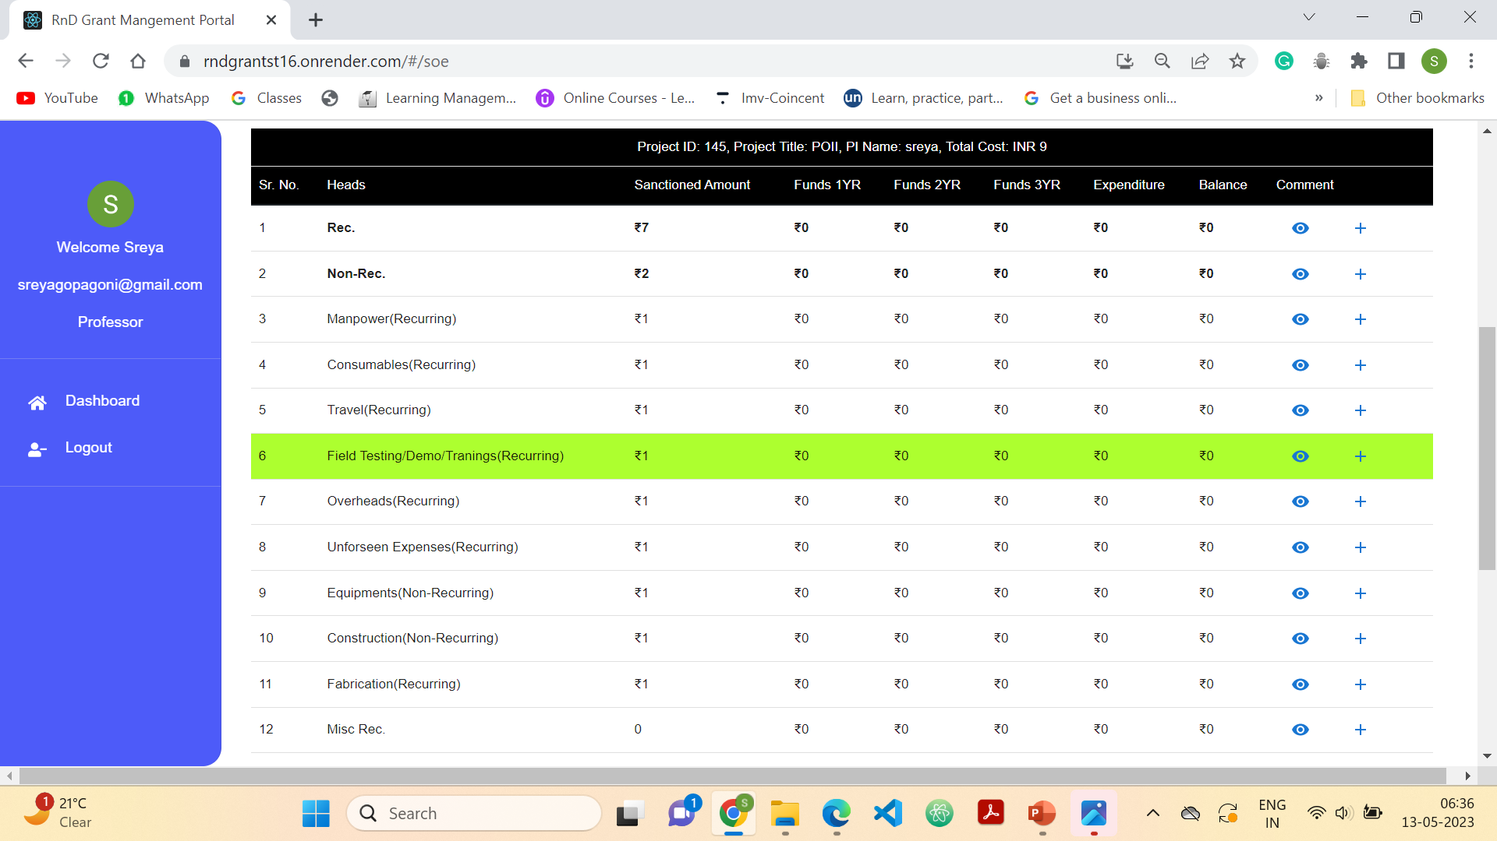
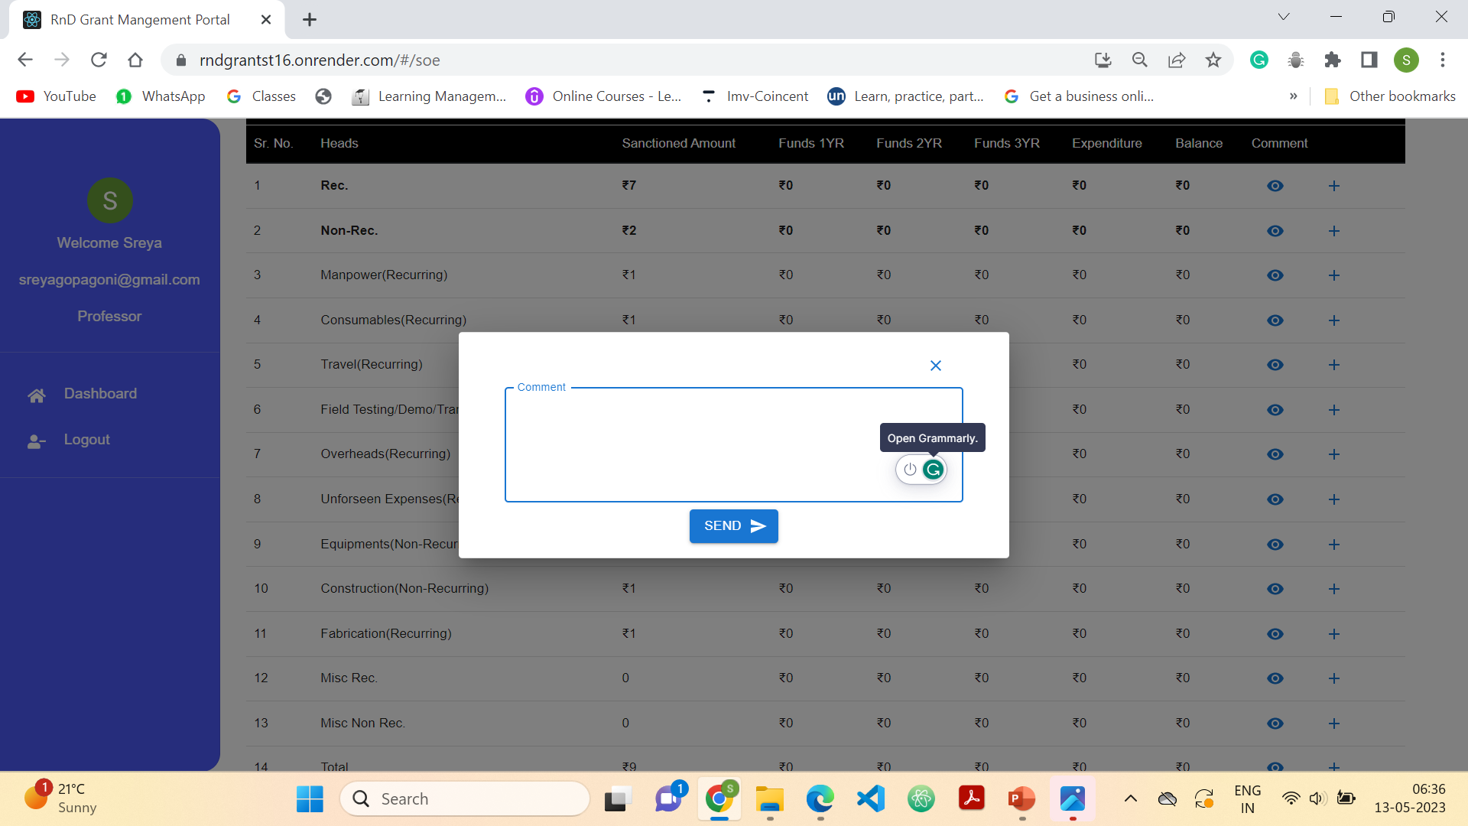
Functionality – Professor or Fellow(comment)

Slide 26
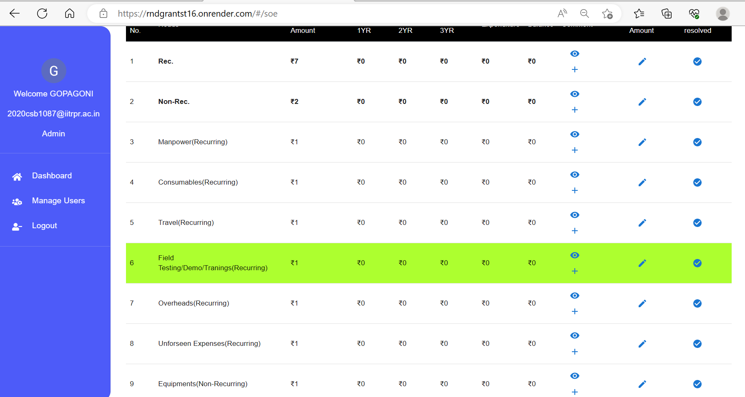
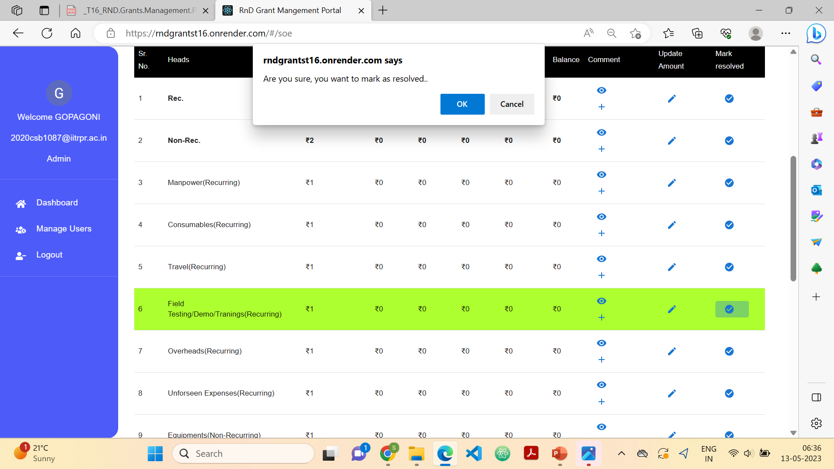
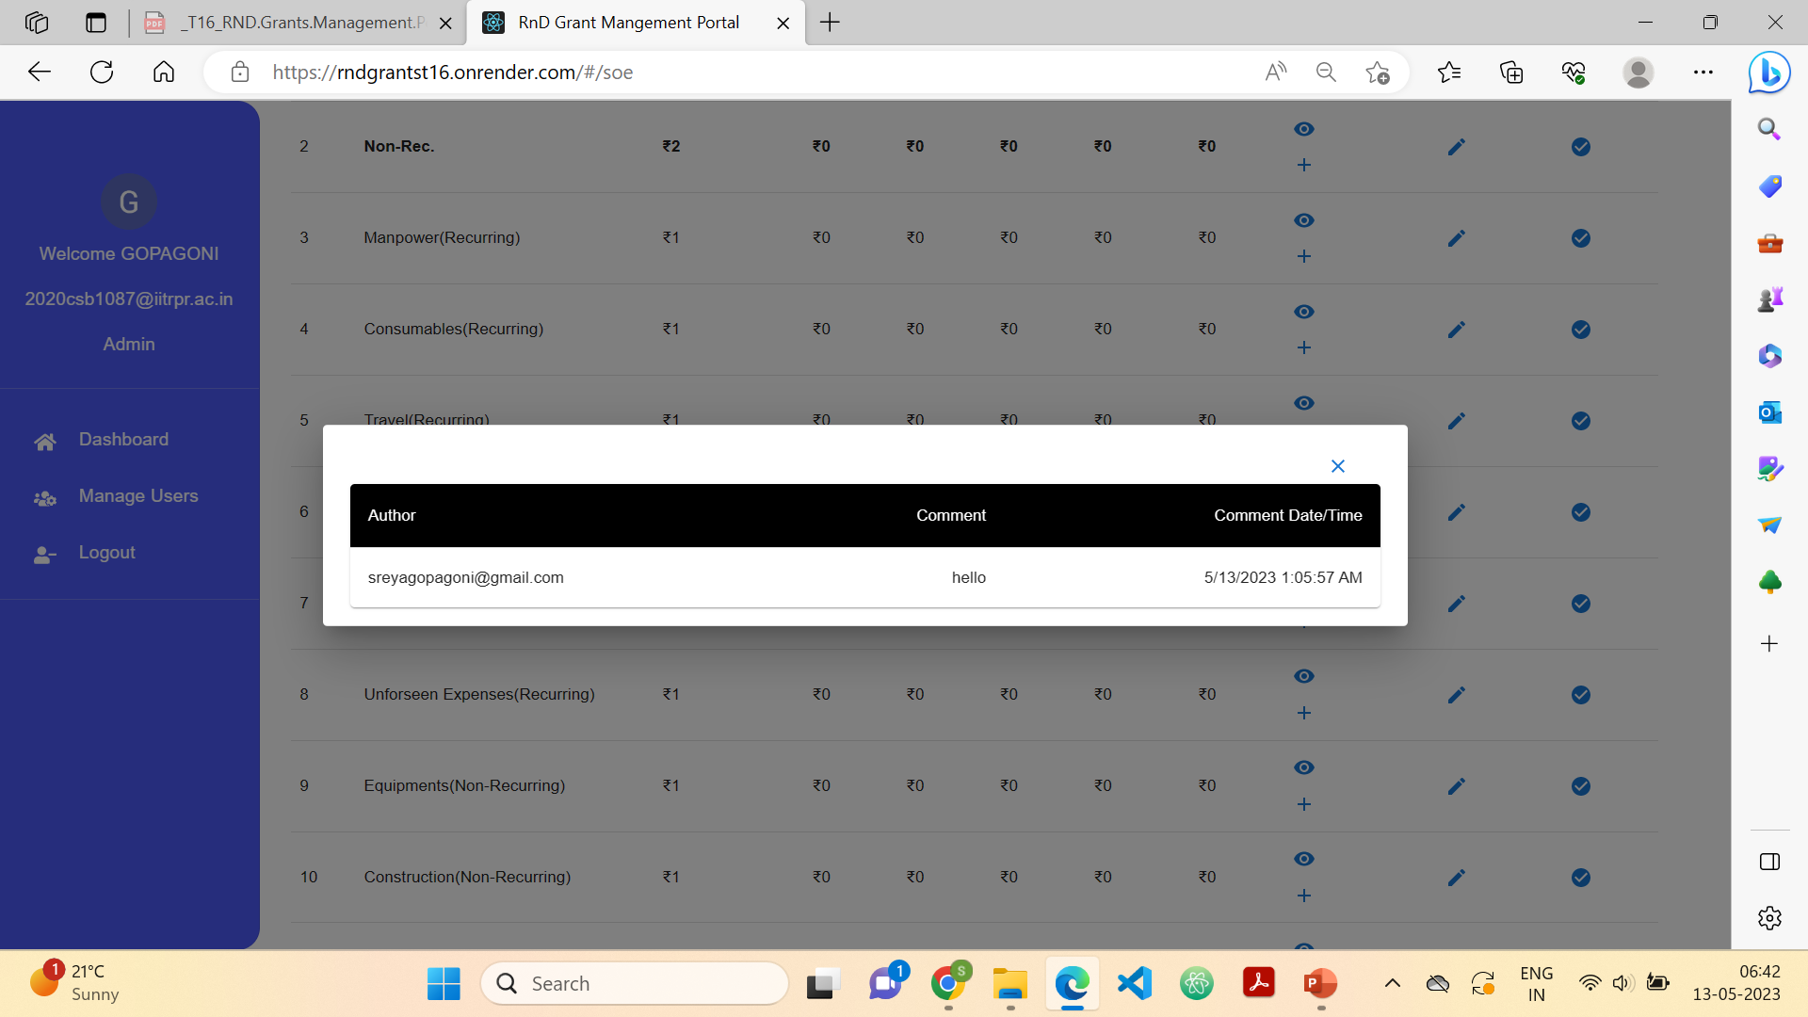
Functionality – Admin(comment)

Slide 27
Fellow page

Slide 28
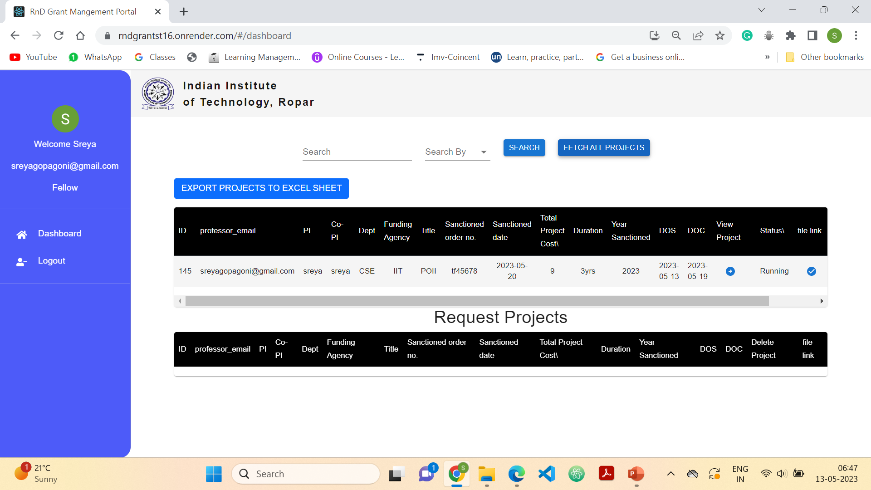
Can only view the projects in which he was added as a fellow and cannot delete or add projects

Slide 29
Feedback from our Stakeholders
Good evening sir,
I have seen the RnD grants management portal made by the team T16(lashyanth, sreya, vishnu, shruti). It is quiet good and is converging with the actual working of our rnd department and it is resolving many issues which we are facing due to manual processing. They have improved the working of their application with our continuous feedback and it now a ready to use portal.

Slide 30
Acknowledgement
We would like to take this opportunity to express our sincere gratitude to all those who have supported us in the completion of this project.
First and foremost, we would like to thank my supervisor, Dr. Puneet Goyal for his invaluable guidance throughout the project. His expertise and insights have been instrumental in shaping the direction of this work.
we would like to express our gratitude to our seniors Vishwam Datta, Ayush Verma, Anshu Kumar, Himanshu Yadav whose project we extended.
Further we would also like to thank our stakeholders Rnd management section who helped us with continues and valuable feedbacks.
Thank you all for your motivation throughout the course of this project.

Slide 31
Thank you

